Slide 1
Performance Measurement in Decentralized Organizations
Chapter 11
Notes:
Chapter 11: Performance Measurement in Decentralized Organizations
Managers in large organizations have to delegate some decisions to those who are at lower levels in the organization. This chapter explains how responsibility accounting systems, return on investment (ROI), residual income, operating performance measures, and the balanced scorecard are used to help control decentralized organizations.

Slide 2
Decentralization in Organizations
Benefits of
Decentralization
Top management
freed to concentrate
on strategy.
Lower-level decisions
often based on
better information.
Lower level managers can respond quickly to customers.
Lower-level managers
gain experience in
decision-making.
Decision-making
authority leads to
job satisfaction.
Notes:
A decentralized organization does not confine decision-making authority to a few top executives; rather, decision-making authority is spread throughout the organization. The advantages of decentralization are as follows:
It enables top management to concentrate on strategy, higher-level decision-making, and coordinating activities.
It acknowledges that lower-level managers have more detailed information about local conditions that enable them to make better operational decisions.
It enables lower-level managers to quickly respond to customers.
It provides lower-level managers with the decision-making experience they will need when promoted to higher level positions.
It often increases motivation, resulting in increased job satisfaction and retention, as well as improved performance.

Slide 3
Decentralization in Organizations
Lower-level managers
may make decisions
without seeing the
“big picture.”
May be a lack of
coordination among
autonomous
managers.
Disadvantages of
Decentralization
Lower-level manager’s
objectives may not
be those of the
organization.
May be difficult to
spread innovative ideas
in the organization.
Notes:
The disadvantages of decentralization are as follows:
Lower-level managers may make decisions without fully understanding the “big picture.”
There may be a lack of coordination among autonomous managers. The balanced scorecard can help reduce this problem by communicating a company’s strategy throughout the organization.
Lower-level managers may have objectives that differ from those of the entire organization. This problem can be reduced by designing performance evaluation systems that motivate managers to make decisions which are in the best interests of the company.
It may be difficult to effectively spread innovative ideas in a strongly decentralized organization. This problem can be reduced through the effective use of intranet systems, which enable globally dispersed employees to electronically share ideas.

Slide 4
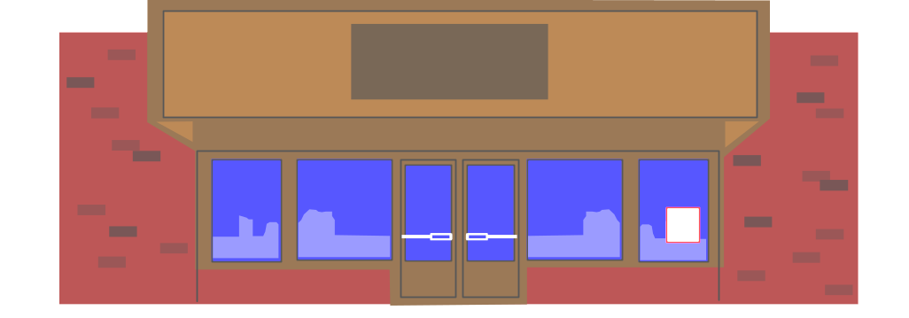


Decentralization and Segment Reporting
An Individual Store
Quick Mart
A segment is any part or activity of an organization about which a manager seeks cost, revenue, or profit data.
A Sales Territory
A Service Center
Notes:
A segment is a part or activity of an organization about which managers would like cost, revenue, or profit data. Examples of segments include divisions of a company, sales territories, individual stores, service centers, manufacturing plants, marketing departments, individual customers, and product lines.

Slide 5

Keys to Segmented Income Statements
There are two keys to building segmented income statements:
A contribution format should be used because it separates fixed from variable costs and it enables the calculation of a contribution margin.
Traceable fixed costs should be separated from common fixed costs to enable the calculation of a segment margin.
Notes:
There are two keys to building segmented income statements.
First, a contribution format should be used because it separates fixed from variable costs and it enables the calculation of a contribution margin. The contribution margin is especially useful in decisions involving temporary uses of capacity, such as special orders.
Second, traceable fixed costs should be separated from common fixed costs to enable the calculation of a segment margin.

Slide 6


Identifying Traceable Fixed Costs
Traceable fixed costs arise because of the existence of a particular segment and would disappear over time if the segment itself disappeared.
No computer
division means . . .
No computer
division manager.
Notes:
A traceable fixed cost of a segment is a fixed cost that is incurred because of the existence of the segment. If the segment were eliminated, the fixed cost would disappear. Examples of traceable fixed costs include the following:
The salary of the Fritos product manager at PepsiCo is a traceable fixed cost of the Fritos business segment of PepsiCo.
The maintenance cost for the building in which Boeing 747s are assembled is a traceable fixed cost of the 747 business segment of Boeing.

Slide 7

Identifying Common Fixed Costs
Common fixed costs arise because of the overall operation of the company and would not disappear if any particular segment were eliminated.
No computer
division but . . .
We still have a
company president.
Notes:
A common fixed cost is a fixed cost that supports the operations of more than one segment, but is not traceable in whole or in part to any one segment. Examples of common fixed costs include the following:
The salary of the CEO of General Motors is a common fixed cost of the various divisions of General Motors.
The cost of heating a Safeway or Kroger grocery store is a common fixed cost of the various departments – groceries, produce, and bakery.

Slide 8

Traceable Costs Can Become
Common Costs
It is important to realize that the traceable fixed costs of one segment may be a common fixed cost of another segment.
For example, the landing fee paid to land an airplane at an airport is traceable to the particular flight, but it is not traceable to first-class, business-class, and economy-class passengers.
Notes:
It is important to realize that the traceable fixed costs of one segment may be a common fixed cost of another segment. For example, the landing fee paid to land an airplane at an airport is traceable to a particular flight, but it is not traceable to first-class, business-class, and economy-class passengers.

Slide 9
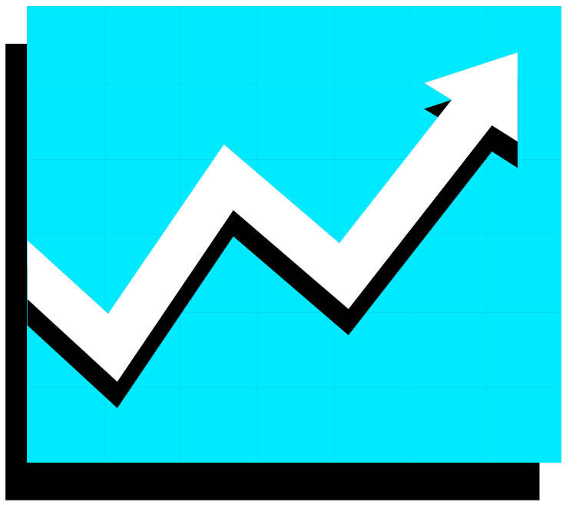
Segment Margin
The segment margin, which is computed by subtracting the traceable fixed costs of a segment from its contribution margin, is the best gauge of the long-run profitability of a segment.
Profits
Time
Notes:
A segment margin is computed by subtracting the traceable fixed costs of a segment from its contribution margin. The segment margin is a valuable tool for assessing the long-run profitability of a segment.

Slide 10
Traceable and Common Costs
Fixed
Costs
Don’t allocate
common costs to segments.
Traceable
Common
Notes:
Allocating common costs to segments reduces the value of the segment margin as a guide to long-run segment profitability.
As a result, common costs should not be allocated to segments.

Slide 11
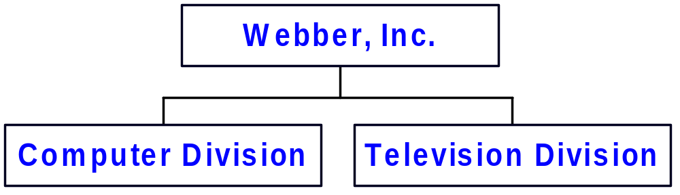
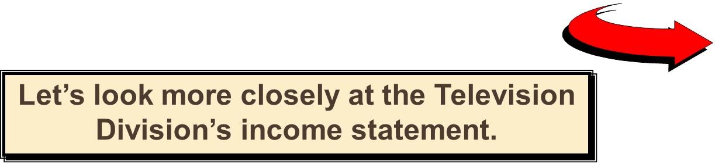
Levels of Segmented Statements
Webber, Inc. has two divisions.
Notes:
Assume that Webber, Inc. has two divisions – the Computer Division and the Television Division.

Slide 12
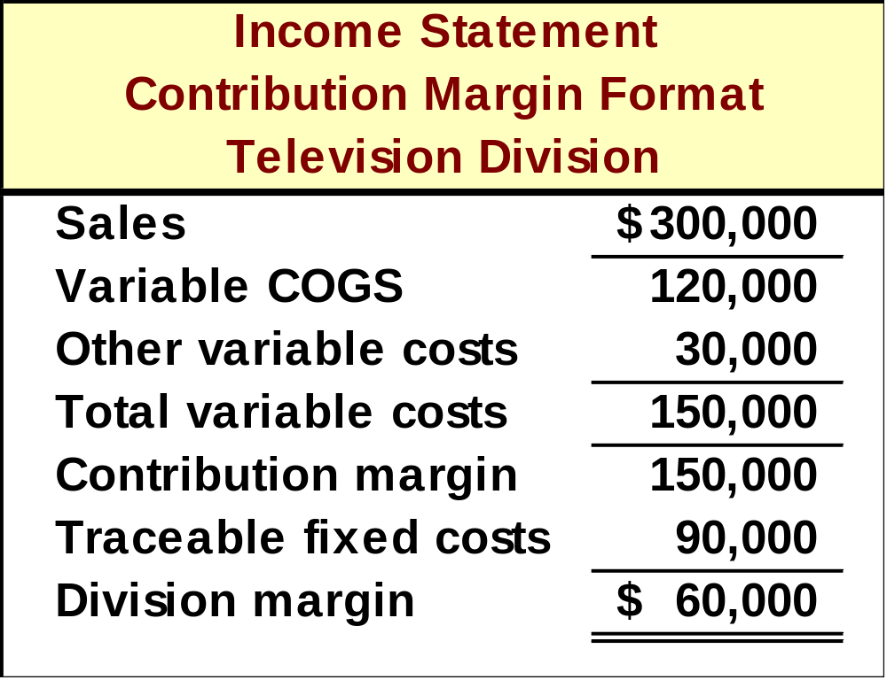
Levels of Segmented Statements
Our approach to segment reporting uses the contribution format.
Cost of goods
sold consists of
variable
manufacturing
costs.
Fixed and
variable costs
are listed in
separate
sections.
Notes:
The contribution format income statement for the Television Division is as shown. Notice that:
Cost of goods sold consists of variable manufacturing costs; and
Fixed and variable costs are listed in separate sections.

Slide 13
Levels of Segmented Statements
Our approach to segment reporting uses the contribution format.
Contribution margin
is computed by taking sales minus variable costs.
Segment margin
is Television’s
contribution
to profits.
Notes:
Also notice that:
Contribution margin is computed by subtracting variable costs from sales; and
The divisional segment margin represents the Television Division’s contribution to overall company profits.

Slide 14
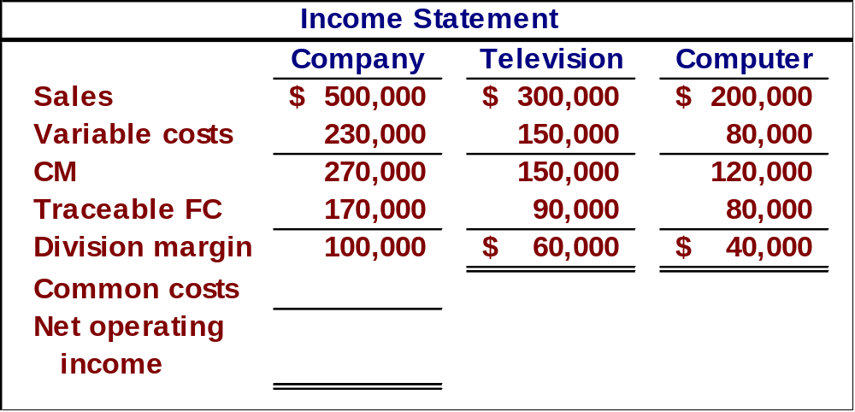
Levels of Segmented Statements
Notes:
The Television Division’s results can be rolled into Webber, Inc.’s overall results as shown. Notice that the results of the Television and Computer Divisions sum to the results shown for the whole company.

Slide 15
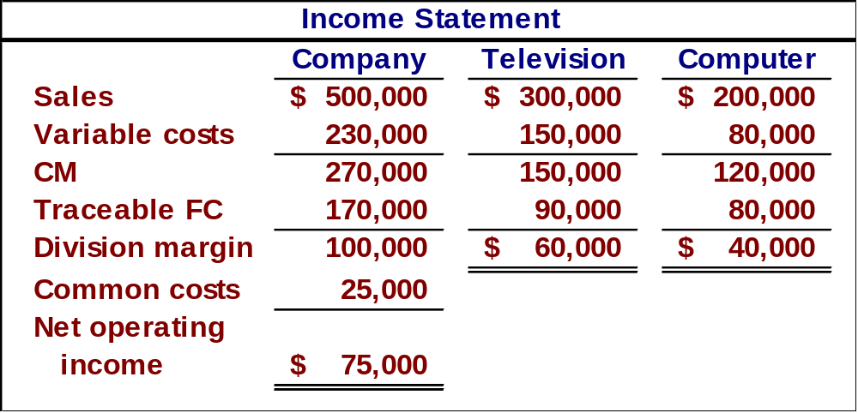
Levels of Segmented Statements
Common costs should not be allocated to the divisions. These costs would remain even if one of the divisions were eliminated.
Notes:
The common costs for the company as a whole ($25,000) are not allocated to the divisions. Common costs are not allocated to segments because these costs would remain even if one of the divisions were eliminated.

Slide 16

Traceable Costs Can Become
Common Costs
As previously mentioned, fixed costs that are traceable to one segment can become common if the company is divided into smaller segments.
Let’s see how this works using the Webber, Inc. example!
Notes:
The Television Division’s results can also be broken down into smaller segments. This enables us to see how traceable fixed costs of the Television Division can become common costs of smaller segments.

Slide 17
Traceable Costs Can Become
Common Costs
Webber’s Television Division
Television
Division
LCD
Plasma
Product
Lines
Notes:
Assume that the Television Division can be broken down into two major product lines – Regular and Big Screen.

Slide 18
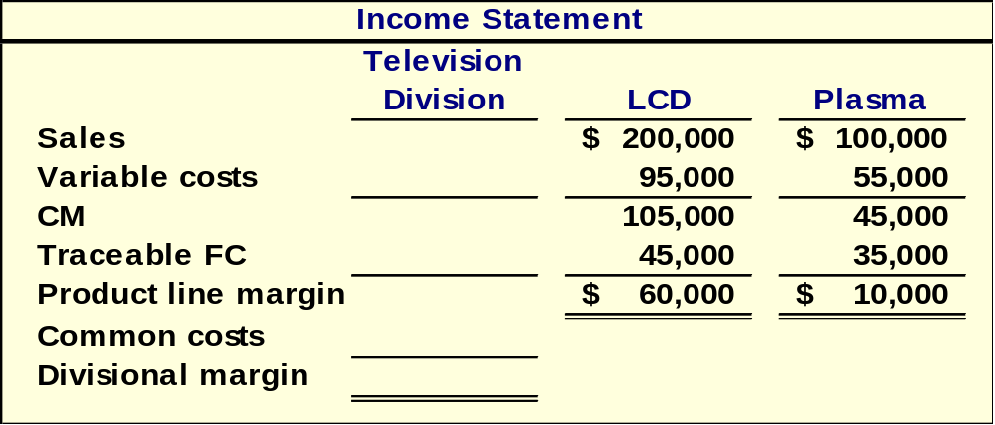
Traceable Costs Can Become
Common Costs
We obtained the following information from
the LCD and Plasma segments.
Notes:
Assume that the segment margins for these two product lines are as shown.

Slide 19
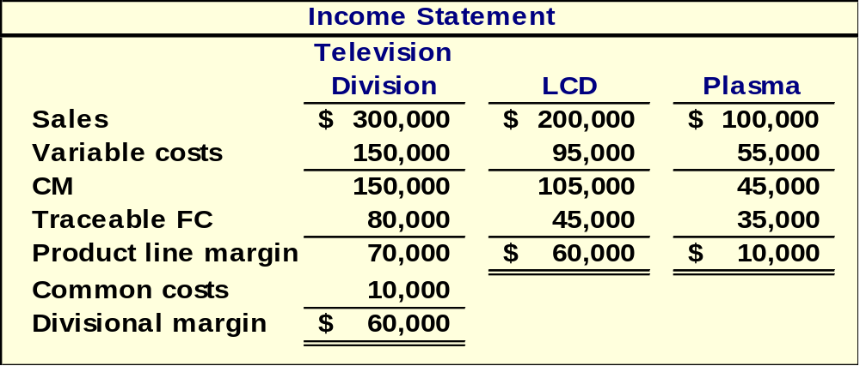
Traceable Costs Can Become
Common Costs
Fixed costs directly traced
to the Television Division
$80,000 + $10,000 = $90,000
Notes:
Of the $90,000 of fixed costs that were previously traceable to the Television Division, only $80,000 is traceable to the two product lines and $10,000 is a common cost.

Slide 20

Segmented Income Statements and Decision Making
5% increase in sales
$5,000 additional
advertising
Division margin
increases by
$2,500
Margin
increases
by $5,250
Margin
increases
by $2,250
Notes:
The Television Division’s results can also be used for decision making. For example, assume Webber believes that if the Television Division spends $5,000 additional dollars on advertising it will increase sales of Regular and Big Screen televisions by 5%. Webber can compute the profit impact of this course of action as follows:
a. The Regular contribution margin would increase by $5,250.
b. The Big Screen contribution margin would increase by $2,250.
c. The Television Division’s segment margin would increase by $2,500.

Slide 21





Inappropriate Methods of Allocating Costs Among Segments
Failure to trace
costs directly
Inappropriate
allocation base
Segment
1
Segment
2
Segment
3
Segment
4
Notes:
Costs that can be traced directly to specific segments of a company should not be allocated to other segments. Rather, such costs should be charged directly to the responsible segment. For example, the rent for a branch office of an insurance company should be charged directly against the branch office rather than included in a companywide overhead pool and then spread throughout the company.
Some companies allocate costs to segments using arbitrary bases. Costs should be allocated to segments for internal decision making purposes only when the allocation base actually drives the cost being allocated. For example, sales is frequently used to allocate selling and administrative expenses to segments. This should only be done if sales drive these expenses.

Slide 22
Common Costs and Segments
Common costs should not be arbitrarily allocated to segments based on the rationale that “someone has to cover the common costs” for two reasons:
This practice may make a profitable business segment appear to be unprofitable.
Allocating common fixed costs forces managers to be held accountable for costs they cannot control.
Segment
1
Segment
2
Segment
3
Segment
4
Notes:
Common costs should not be arbitrarily allocated to segments based on the rationale that “someone has to cover the common costs” for two reasons:
First, this practice may make a profitable business segment appear to be unprofitable. If the segment is eliminated the revenue lost may exceed the traceable costs that are avoided.
Second, allocating common fixed costs forces managers to be held accountable for costs that they cannot control.

Slide 23
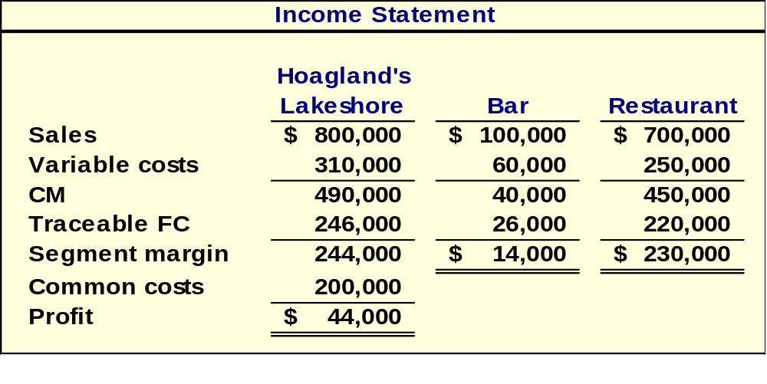
Quick Check ✓
Assume that Hoagland's Lakeshore prepared its segmented income statement as shown.
Notes:
Assume that Hoagland's Lakeshore prepared the segmented income statement as shown.

Slide 24
Quick Check ✓
How much of the common fixed cost of $200,000 can be avoided by eliminating the bar?
  a. None of it.
  b. Some of it.
  c. All of it.
Notes:
How much of the common fixed cost of $200,000 can be avoided by eliminating the bar?

Slide 25
Quick Check ✓
Suppose square feet is used as the basis for allocating the common fixed cost of $200,000. How much would be allocated to the bar if the bar occupies 1,000 square feet and the restaurant 9,000 square feet?
  a. $20,000
  b. $30,000
  c. $40,000
  d. $50,000
Notes:
Suppose square feet is used as the basis for allocating the common fixed cost of $200,000. How much would be allocated to the bar if the bar occupies 1,000 square feet and the restaurant 9,000 square feet?

Slide 26

Quick Check ✓
If Hoagland's allocates its common costs to the bar and the restaurant, what would be the reported profit of each segment?
Notes:
If Hoagland's allocates its common costs to the bar and the restaurant, what would be the reported profit of each segment?

Slide 27
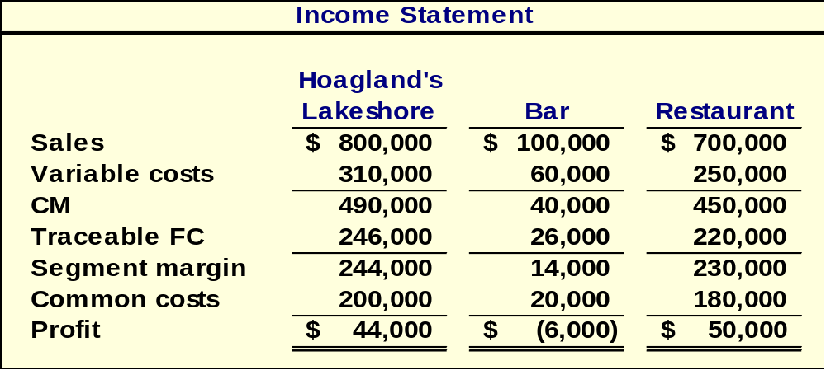

Allocations of Common Costs
Hurray, now everything adds up!!!
Notes:
Take a minute and review this slide. Notice that the common costs of $200,000 are allocated to the bar and restaurant.

Slide 28
Quick Check ✓
Should the bar be eliminated?
  a. Yes
  b. No
Notes:
Should the bar be eliminated?

Slide 29
Cost, Profit, and Investments Centers
Cost
Center
Profit
Center
Investment
Center
Cost, profit,
and investment
centers are all
known as
responsibility
centers.
Responsibility
Center
Notes:
Responsibility accounting systems link lower-level managers’ decision-making authority with accountability for the outcomes of those decisions. The term responsibility center is used for any part of an organization whose manager has control over, and is accountable for cost, profit, or investments. The three primary types of responsibility centers are cost centers, profit centers, and investment centers.

Slide 30

Cost Center
A segment whose manager has control over costs, but not over revenues or investment funds.
Notes:
The manager of a cost center has control over costs, but not over revenue or investment funds.
Service departments such as accounting, general administration, legal, and personnel are usually classified as cost centers, as are manufacturing facilities. Standard cost variances and flexible budget variances, such as those discussed in Chapters 10 and 11, are often used to evaluate cost center performance.

Slide 31
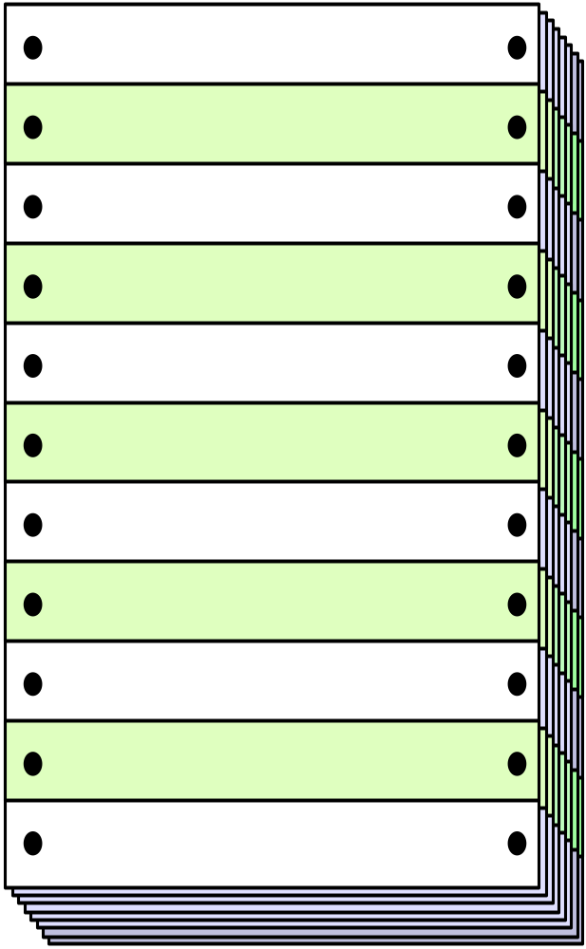
Profit Center
Revenues
A segment whose manager has control over both costs and revenues,
but no control over investment funds.
Sales
Interest
Other
Costs
Mfg. costs
Commissions
Salaries
Other
Notes:
The manager of a profit center has control over both costs and revenue. Profit center managers are often evaluated by comparing actual profit to targeted or budgeted profit. An example of a profit center is a company’s cafeteria.

Slide 32

Investment Center
Corporate Headquarters
A segment whose manager has control over costs, revenues, and investments in operating assets.
Notes:
The manager of an investment center has control over cost, revenue, and investments in operating assets. Investment center managers are often evaluated using return on investment (ROI) or residual income (discussed later in this chapter). An example of an investment center would be the corporate headquarters.

Slide 33
Learning Objective 1
Compute return on investment (ROI) and show how changes in sales, expenses, and assets affect ROI.
Notes:
Learning Objective 1: Compute return on investment (ROI) and show how changes in sales, expenses, and assets affect ROI.

Slide 34

Return on Investment (ROI) Formula
Income before interest
and taxes (EBIT)
Net operating income
Average operating assets
ROI =
Cash, accounts receivable, inventory,
plant and equipment, and other
productive assets.
Notes:
An investment center’s performance is often evaluated using a measure called return on investment (ROI). ROI is defined as net operating income divided by average operating assets.
Net operating income is income before taxes and is sometimes referred to as earnings before interest and taxes (EBIT). Operating assets include cash, accounts receivable, inventory, plant and equipment, and all other assets held for operating purposes.
Net operating income is used in the numerator because the denominator consists only of operating assets.
The operating asset base used in the formula is typically computed as the average of the operating assets (beginning assets + ending assets/2).

Slide 35

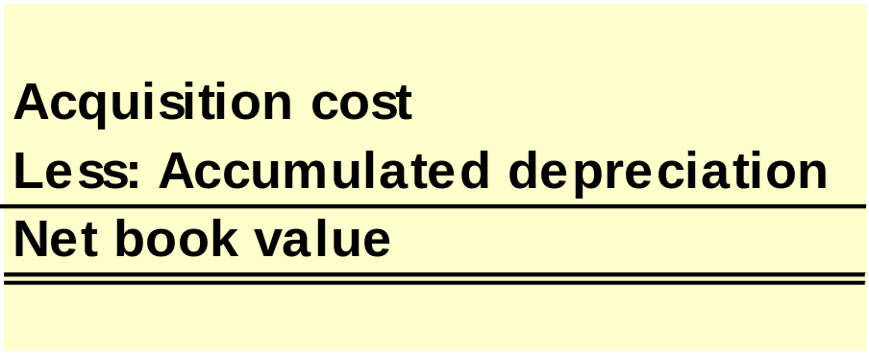
Net Book Value versus Gross Cost
Most companies use the net book value of depreciable assets to calculate average operating assets.
Notes:
Most companies use the net book value (i.e., acquisition cost less accumulated depreciation) of depreciable assets to calculate average operating assets. With this approach, ROI mechanically increases over time as the accumulated depreciation increases. Replacing a fully-depreciated asset with a new asset will decrease ROI.
An alternative to using net book value is the use of the gross cost of the asset, which ignores accumulated depreciation. With this approach, ROI does not grow automatically over time, rather it stays constant; thus, replacing a fully-depreciated asset does not adversely affect ROI.

Slide 36
Understanding ROI
Net operating income
Average operating assets
ROI =
Net operating income
Sales
Margin =
Sales
Average operating assets
Turnover =
ROI =
Margin × Turnover
Notes:
DuPont pioneered the use of ROI and recognized the importance of looking at the components of ROI, namely margin and turnover.
Margin is computed as shown and is improved by increasing sales or reducing operating expenses. The lower the operating expenses per dollar of sales, the higher the margin earned.
Turnover is computed as shown. It incorporates a crucial area of a manager’s responsibility – the investment in operating assets. Excessive funds tied up in operating assets depress turnover and lower ROI.

Slide 37
Increasing ROI – An Example
Regal Company reports the following:
Net operating income $ 30,000
Average operating assets $ 200,000
Sales $ 500,000
Operating expenses $ 470,000
What is Regal Company’s ROI?
ROI =
Margin × Turnover
ROI =
Net operating income
Sales
×
Sales
Average operating assets
Notes:
Assume that Regal Company reports net operating income of $30,000; average operating assets of $200,000; sales of $500,000; and operating expenses of $470,000. What is Regal Company’s ROI?

Slide 38
Increasing ROI – An Example
ROI =
Margin × Turnover
Net operating income
Sales
Sales
Average operating assets
ROI =
×
$30,000
$500,000
$500,000
$200,000
ROI =
×
ROI =
6% × 2.5 = 15%
Notes:
Given this information, its current ROI is 15%.

Slide 39
Investing in Operating Assets to Increase Sales
Assume that Regal's manager invests in a $30,000 piece of equipment that increases sales by $35,000, while increasing operating expenses by $15,000.
Regal Company reports the following:
Net operating income $ 50,000
Average operating assets $ 230,000
Sales $ 535,000
Operating expenses $ 485,000
Let’s calculate the new ROI.
Notes:
The fourth way to increase ROI is to invest in operating assets to increase sales.
Assume that Regal's manager invests $30,000 in a piece of equipment that increases sales by $35,000 while increasing operating expenses by $15,000.
Let’s calculate the new ROI.

Slide 40
Investing in Operating Assets to Increase Sales
ROI =
Margin × Turnover
ROI =
Net operating income
Sales
×
Sales
Average operating assets
$50,000
$535,000
$535,000
$230,000
ROI =
×
ROI =
9.35% × 2.33 = 21.8%
ROI increased from 15% to 21.8%.
Notes:
In this case, the ROI increases from 15% to 21.8%.

Slide 41


Criticisms of ROI
In the absence of the balanced
scorecard, management may
not know how to increase ROI.
Managers often inherit many
committed costs over which
they have no control.
Managers evaluated on ROI
may reject profitable
investment opportunities.
Notes:
Just telling managers to increase ROI may not be enough. Managers may not know how to increase ROI in a manner that is consistent with the company’s strategy.
This is why ROI is best used as part of a balanced scorecard.
A manager who takes over a business segment typically inherits many committed costs over which the manager has no control. This may make it difficult to assess this manager relative to other managers.
A manager who is evaluated based on ROI may reject investment opportunities that are profitable for the whole company but that would have a negative impact on the manager’s performance evaluation.

Slide 42
Learning Objective 2
Compute residual income and understand its strengths and weaknesses.
Notes:
Learning objective number 2 is to compute residual income and understand its strengths and weaknesses.

Slide 43

Residual Income - Another Measure of Performance
Net operating income
above some minimum
return on operating
assets
Notes:
Residual income is the net operating income that an investment center earns above the minimum required return on its assets.
Economic Value Added (EVA) is an adaptation of residual income. We will not distinguish between the two terms in this class.

Slide 44
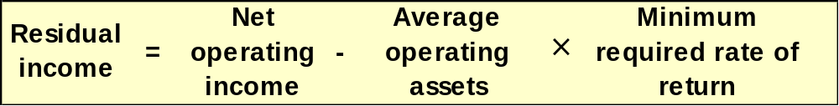
Calculating Residual Income
(
)
This computation differs from ROI.
ROI measures net operating income earned relative to the investment in average operating assets.
Residual income measures net operating income earned less the minimum required return on average operating assets.
Notes:
The equation for computing residual income is as shown. Notice that this computation differs from ROI. ROI measures net operating income earned relative to the investment in average operating assets. Residual income measures net operating income earned less the minimum required return on average operating assets.

Slide 45
Residual Income – An Example
The Retail Division of Zephyr, Inc. has average operating assets of $100,000 and is required to earn a return of 20% on these assets.
In the current period, the division earns $30,000.
Let’s calculate residual income.
Notes:
Assume the information for a division of Zephyr, Inc. is as follows. The Retail Division of Zephyr, Inc. has average operating assets of $100,000 and is required to earn a return of 20% on these assets. In the current period, the division earns $30,000.
Let’s calculate residual income.

Slide 46
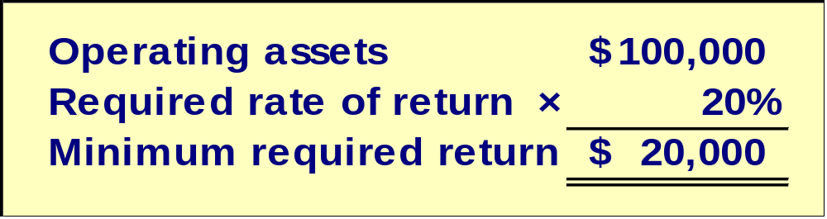
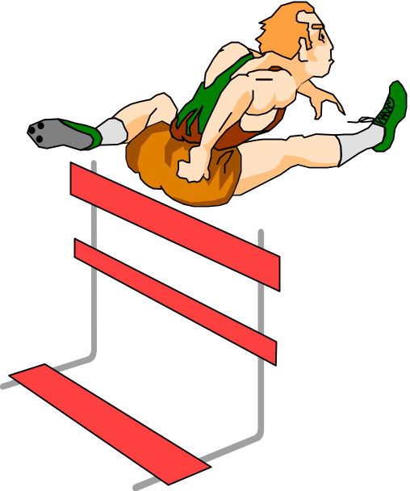
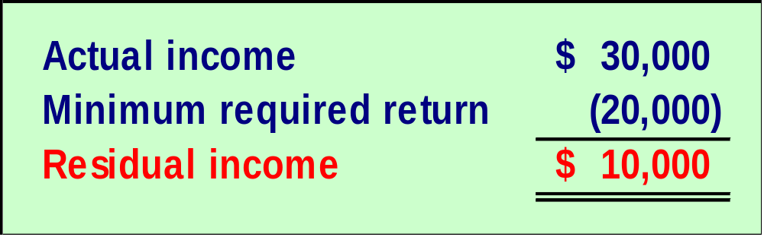
Residual Income – An Example
Notes:
The residual income of $10,000 is computed by subtracting the minimum required return of $20,000 from the actual income of $30,000.

Slide 47

Motivation and Residual Income
Residual income encourages managers to
make profitable investments that would
be rejected by managers using ROI.
Notes:
The residual income approach encourages managers to make investments that are profitable for the entire company but that would be rejected by managers who are evaluated using the ROI formula.
It motivates managers to pursue investments where the ROI associated with those investments exceeds the company’s minimum required return but is less than the ROI being earned by the managers.

Slide 48
Quick Check ✓
Redmond Awnings, a division of Wrap-up Corp., has a net operating income of $60,000 and average operating assets of $300,000. The required rate of return for the company is 15%. What is the division’s ROI?
  a. 25%
  b. 5%
  c. 15%
  d. 20%
Notes:
Redmond Awnings, a division of Wrap-up Corp., has a net operating income of $60,000 and average operating assets of $300,000. The required rate of return for the company is 15%. What is the division’s ROI?

Slide 49
Quick Check ✓
Redmond Awnings, a division of Wrap-up Corp., has a net operating income of $60,000 and average operating assets of $300,000. If the manager of the division is evaluated based on ROI, will she want to make an investment of $100,000 that would generate additional net operating income of $18,000 per year?
  a. Yes
  b. No
Notes:
If the manager of the division is evaluated based on ROI, will she want to make an investment of $100,000 that would generate additional net operating income of $18,000 per year?

Slide 50
Quick Check ✓
The company’s required rate of return is 15%. Would the company want the manager of the Redmond Awnings division to make an investment of $100,000 that would generate additional net operating income of $18,000 per year?
  a. Yes
  b. No
Notes:
The company’s required rate of return is fifteen percent. Would the company want the manager of the Redmond Awnings division to make an investment of $100,000 that would generate additional net operating income of $18,000 per year?

Slide 51
Quick Check ✓
Redmond Awnings, a division of Wrap-up Corp., has a net operating income of $60,000 and average operating assets of $300,000. The required rate of return for the company is 15%. What is the division’s residual income?
  a. $240,000
  b. $ 45,000
  c. $ 15,000
  d. $ 51,000
Notes:
Review this question. What is the division’s residual income?

Slide 52
Quick Check ✓
If the manager of the Redmond Awnings division is evaluated based on residual income, will she want to make an investment of $100,000 that would generate additional net operating income of $18,000 per year?
  a. Yes
  b. No
Notes:
If the manager of the Redmond Awnings division is evaluated based on residual income, will she want to make an investment of $100,000 that would generate additional net operating income of $18,000 per year?

Slide 53

Divisional Comparisons and Residual Income
The residual income approach has one major disadvantage.
It cannot be used to compare the performance of divisions of different sizes.
Notes:
The residual income approach has one major disadvantage. It cannot be used to compare the performance of divisions of different sizes.

Slide 54
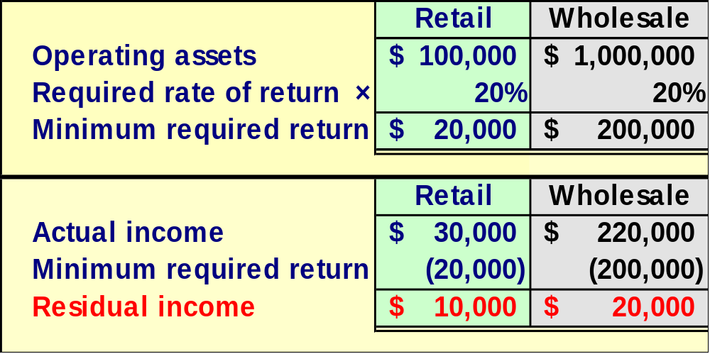
Zephyr, Inc. - Continued
Recall the following information for the Retail Division of Zephyr, Inc.
Assume the following information for the Wholesale Division of Zephyr, Inc.
Notes:
Recall that the Retail Division of Zephyr had average operating assets of $100,000, a minimum required rate of return of 20%, net operating income of $30,000, and residual income of $10,000.
Assume that the Wholesale Division of Zephyr had average operating assets of $1,000,000, a minimum required rate of return of 20%, net operating income of $220,000, and residual income of $20,000.

Slide 55
Learning Objective 3
Compute delivery cycle time, throughput time, and manufacturing cycle efficiency (MCE).
Notes:
Learning objective number 3 is to compute delivery cycle time, throughput time, and manufacturing cycle efficiency (MCE).

Slide 56
Delivery Performance Measures
Order Received
Production
Started
Goods Shipped
Process Time + Inspection Time
+ Move Time + Queue Time
Wait Time
Throughput Time
Delivery Cycle Time
Process time is the only value-added time.
Notes:
Delivery cycle time is the elapsed time from when a customer order is received to when the completed order is shipped.
Throughput (manufacturing cycle) time is the amount of time required to turn raw materials into completed products. This includes process time, inspection time, move time, and queue time. Process time is the only value-added activity of the four times mentioned.

Slide 57
Delivery Performance Measures
Order Received
Production
Started
Goods Shipped
Process Time + Inspection Time
+ Move Time + Queue Time
Wait Time
Throughput Time
Delivery Cycle Time
Manufacturing
Cycle
Efficiency
Value-added time
Manufacturing cycle time
=
Notes:
Manufacturing cycle efficiency (MCE) is computed by dividing value-added time by manufacturing cycle (throughput) time. An MCE less than one indicates that non-value-added time is present in the production process.
Next, we will look at a series of questions dealing with delivery performance measures.

Slide 58
Quick Check ✓
A TQM team at Narton Corp has recorded the following average times for production:
Wait 3.0 days Move 0.5 days
Inspection 0.4 days Queue 9.3 days
Process 0.2 days
What is the throughput time?
  a. 10.4 days.
  b. 0.2 days.
  c. 4.1 days.
  d. 13.4 days.
Notes:
Here’s your first question on delivery performance measures: What is the throughput time?

Slide 59
Quick Check ✓
A TQM team at Narton Corp has recorded the following average times for production:
Wait 3.0 days Move 0.5 days
Inspection 0.4 days Queue 9.3 days
Process 0.2 days
What is the Manufacturing Cycle Efficiency (MCE)?
  a. 50.0%.
  b. 1.9%.
  c. 52.0%.
  d. 5.1%.
Notes:
Here’s your second question on delivery performance measures: What is the manufacturing cycle efficiency?

Slide 60
Quick Check ✓
A TQM team at Narton Corp has recorded the following average times for production:
Wait 3.0 days Move 0.5 days
Inspection 0.4 days Queue 9.3 days
Process 0.2 days
What is the delivery cycle time (DCT)?
  a. 0.5 days.
  b. 0.7 days.
  c. 13.4 days.
  d. 10.4 days.
Notes:
Here’s your third question on delivery performance measures: What is the delivery cycle time?

Slide 61
Learning Objective 4
Understand how to construct and use a balanced scorecard.
Notes:
Learning objective number 4 is to understand how to construct and use a balanced scorecard.

Slide 62
The Balanced Scorecard
Management translates its strategy into performance measures that employees understand and influence.
Financial
Customer
Performance
measures
Internal
business
processes
Learning
and growth
Notes:
A balanced scorecard consists of an integrated set of performance measures that are derived from and support a company’s strategy. Importantly, the measures included in a company’s balanced scorecard are unique to its specific strategy.
The balanced scorecard enables top management to translate its strategy into four groups of performance measures – financial, customer, internal business processes, and learning and growth – that employees can understand and influence.

Slide 63
The Balanced Scorecard: From
Strategy to Performance Measures
Performance Measures
Financial
Has our financial
performance improved?
What are our
financial goals?
What customers do
we want to serve and
how are we going to
win and retain them?
Vision and Strategy
Customer
Do customers recognize that
we are delivering more value?
Internal Business Processes
Have we improved key business processes so that we can deliver more value to customers?
What internal busi-
ness processes are
critical to providing
value to customers?
Learning and Growth
Are we maintaining our ability
to change and improve?
Notes:
The premise of these four groups of measures is that learning is necessary to improve internal business processes. This in turn improves the level of customer satisfaction, thereby improving financial results. Note the emphasis on improvement, not just attaining some specific objective.

Slide 64
The Balanced Scorecard:
Non-financial Measures
The balanced scorecard relies on non-financial measures in addition to financial measures for two reasons:
Financial measures are lag indicators that summarize
the results of past actions. Non-financial measures are
leading indicators of future financial performance.
Top managers are ordinarily responsible for financial
performance measures – not lower level managers.
Non-financial measures are more likely to be
understood and controlled by lower level managers.
Notes:
The balanced scorecard relies on non-financial measures in addition to financial measures for two reasons:
 Financial measures are lag indicators that summarize the results of past actions. Non-financial measures are leading indicators of future financial performance.
Top managers are ordinarily responsible for financial performance measures – not lower level managers. Non-financial measures are more likely to be understood and controlled by lower level managers.

Slide 65


The Balanced Scorecard for Individuals
The entire organization should have an overall balanced scorecard.
Each individual should have a personal balanced scorecard.
A personal scorecard should contain measures that can be
influenced by the individual being evaluated and that
support the measures in the overall balanced scorecard.
Notes:
While the entire organization has an overall balanced scorecard, each responsible individual should have his or her own personal scorecard as well.
A personal scorecard should contain measures that can be influenced by the individual being evaluated and that support the measures in the overall balanced scorecard.

Slide 66
The Balanced Scorecard
A balanced scorecard should have measures
that are linked together on a cause-and-effect basis.
If we improve
one performance
measure . . .
Another desired
performance measure
will improve.
Then
The balanced scorecard lays out concrete actions to attain desired outcomes.
Notes:
A balanced scorecard, whether for an individual or the company as a whole, should have measures that are linked together on a cause-and-effect basis. Each link can be read as a hypothesis in the form “If we improve this performance measure, then this other performance measure should also improve.” In essence, the balanced scorecard lays out a theory of how a company can take concrete actions to attain desired outcomes. If the theory proves false or the company alters its strategy, the measures within the scorecard are subject to change.

Slide 67

The Balanced Scorecard and Compensation
Incentive compensation should be linked to
balanced scorecard performance measures.
Notes:
Incentive compensation for employees probably should be linked to balanced scorecard performance measures. However, this should only be done after the organization has been successfully managed with the scorecard for some time – perhaps a year or more. Managers must be confident that the measures are reliable, not easily manipulated, and understandable by those being evaluated with them.

Slide 68
Transfer Pricing
Appendix 11A
Notes:
Appendix 11A: Transfer Pricing

Slide 69



Key Concepts/Definitions
A transfer price is the price charged when one segment of a company provides goods or services to another segment of the company.
The fundamental objective in setting transfer prices is to motivate managers to act in the best interests of the overall company.
Notes:
A transfer price is the price charged when one segment of a company provides goods or services to another segment of the company. While domestic transfer prices have no direct effect on the entire company’s reported profit, they can have a dramatic effect on the reported profitability of a division.
The fundamental objective in setting transfer prices is to motivate managers to act in the best interests of the overall company. Suboptimization occurs when managers do not act in the best interests of the overall company or even their own divisions.

Slide 70
Three Primary Approaches
There are three primary approaches to setting transfer prices:
Negotiated transfer prices;
Transfers at the cost to the selling division; and
Transfers at market price.
Notes:
There are three primary approaches to setting transfer prices, namely negotiated transfer prices, transfers at the cost to the selling division, and transfers at market price.

Slide 71
Learning Objective 5
Determine the range, if any, within which a negotiated transfer price should fall.
Notes:
Learning objective number 5 is to determine the range, if any, within which a negotiated transfer price should fall.

Slide 72
Negotiated Transfer Prices
A negotiated transfer price results from discussions between the selling and buying divisions.
Range of Acceptable Transfer Prices
Advantages of negotiated transfer prices:
They preserve the autonomy of the divisions, which is consistent with the spirit of decentralization.
The managers negotiating the transfer price are likely to have much better information about the potential costs and benefits of the transfer than others in the company.
Upper limit is determined by the buying division.
Lower limit is determined by the selling division.
Notes:
A negotiated transfer price results from discussions between the selling and buying divisions.
Negotiated transfer prices have two advantages.
First, they preserve the autonomy of the divisions, which is consistent with the spirit of decentralization. The managers negotiating the transfer price are likely to have much better information about the potential costs and benefits of the transfer than others in the company.
Second, the range of acceptable transfer prices is the range of transfer prices within which the profits of both divisions participating in the transfer would increase. The lower limit is determined by the selling division. The upper limit is determined by the buying division.

Slide 73

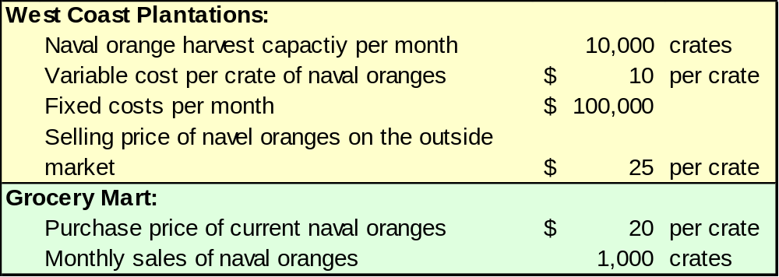
Grocery Storehouse – An Example
Assume the information as shown with respect to West Coast Plantations and Grocery Mart (both companies are owned by Grocery Storehouse).
Notes:
Assume the information as shown with respect to West Coast Plantations and Grocery Mart (both companies are owned by Grocery Storehouse).

Slide 74
Grocery Storehouse – An Example
The selling division’s (West Coast Plantations) lowest acceptable transfer price is calculated as:
Let’s calculate the lowest and highest acceptable transfer prices under three scenarios.
The buying division’s (Grocery Mart) highest acceptable transfer price is calculated as:
If an outside supplier does not exist, the highest acceptable transfer price is calculated as:
Notes:
The selling division’s (West Coast Plantations) lowest acceptable transfer price is calculated as shown.
The buying division’s (Grocery Mart) highest acceptable transfer price is calculated as shown.
If Grocery Mart had no outside supplier for naval oranges, then its highest acceptable transfer price would be equal to the amount it expects to earn by selling the naval oranges, net of its own expenses.
Let’s calculate the lowest and highest acceptable transfer prices under three scenarios.

Slide 75
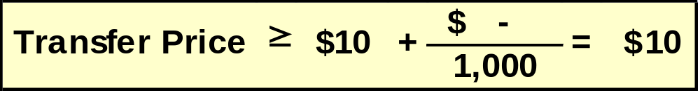
Grocery Storehouse – An Example
If West Coast Plantations has sufficient idle capacity (3,000 crates) to satisfy Grocery Mart’s demands (1,000 crates), without sacrificing sales to other customers, then the lowest and highest possible transfer prices are computed as follows:
Selling division’s lowest possible transfer price:
Buying division’s highest possible transfer price:
Therefore, the range of acceptable transfer prices is $10 – $20.
Notes:
If West Coast Plantations has sufficient idle capacity (3,000 crates) to satisfy Grocery Mart’s demands (1,000 crates) without sacrificing sales to other customers, then the lowest and highest possible transfer prices will be computed as follows.
The lowest acceptable transfer price, as determined by the seller, is $10.
The highest acceptable transfer price, as determined by the buyer, is $20. Therefore, the range of acceptable transfer prices is $10 to $20.

Slide 76
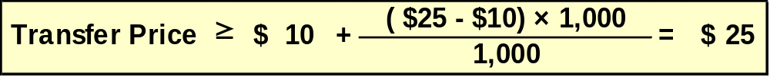
Grocery Storehouse – An Example
If West Coast Plantations has no idle capacity (0 crates) and must sacrifice other customer orders (1,000 crates) to meet Grocery Mart’s demands (1,000 crates), then the lowest and highest possible transfer prices are computed as follows:
Selling division’s lowest possible transfer price:
Buying division’s highest possible transfer price:
Therefore, there is no range of acceptable transfer prices.
Notes:
If West Coast Plantations has no idle capacity and must sacrifice other customer orders (1,000 crates) to meet the demands of Grocery Mart (1,000 crates), then the lowest and highest possible transfer prices will be computed as follows.
The lowest acceptable transfer price, as determined by the seller, is $25.
The highest acceptable transfer price, as determined by the buyer, is $20. Therefore, there is no range of acceptable transfer prices. This is a desirable outcome for Grocery Storehouse because it would be illogical to give up sales of $25 to save costs of $20.

Slide 77
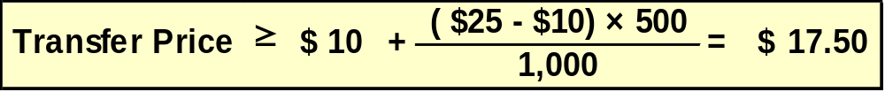
Grocery Storehouse – An Example
If West Coast Plantations has some idle capacity (500 crates) and must sacrifice other customer orders (500 crates) to meet Grocery Mart’s demands (1,000 crates), then the lowest and highest possible transfer prices are computed as follows:
Selling division’s lowest possible transfer price:
Buying division’s highest possible transfer price:
Therefore, the range of acceptable transfer prices is $17.50 – $20.00.
Notes:
If West Coast Plantations has some idle capacity (500 crates) and must sacrifice other customer orders (500 crates) to meet the demands of Grocery Mart (1,000 crates), then the lowest and highest possible transfer prices will be computed as follows.
The lowest acceptable transfer price, as determined by the seller, is $17.50.
The highest acceptable transfer price, as determined by the buyer, is $20. Therefore, the range of acceptable transfer prices is $17.50 to $20.00.

Slide 78

Transfers at the Cost to the Selling Division
Many companies set transfer prices at either the variable cost or full (absorption) cost incurred by the selling division.
Drawbacks of this approach include:
Using full cost as a transfer price can lead to suboptimization.
The selling division will never show a profit on any internal transfer.
Cost-based transfer prices do not provide incentives to control costs.
Notes:
Many companies set transfer prices at either the variable cost or full (absorption) cost incurred by the selling division. The drawbacks of this approach include:
Using full cost as a transfer price can lead to suboptimization because it does not distinguish between variable costs, which may be relevant to the transfer pricing decision, and fixed costs, which may be irrelevant.
If cost is used as the transfer price, the selling division will never show a profit on any internal transfer. The only division that shows a profit is the division that makes the final sale to an outside party.
Cost-based transfer prices do not provide incentives to control costs. If the actual costs of one division are passed on to the next, there is little incentive for anyone to work on reducing costs.

Slide 79

Transfers at Market Price
A market price (i.e., the price charged for an item on the open market) is often regarded as the best approach to the transfer pricing problem.
A market price approach works best when the product or service is sold in its present form to outside customers and the selling division has no idle capacity.
A market price approach does not work well when the selling division has idle capacity.
Notes:
A market price (i.e., the price charged for an item on the open market) is often regarded as the best approach to the transfer pricing problem.
It works best when the product or service is sold in its present form to outside customers and the selling division has no idle capacity.
With no idle capacity the real cost of the transfer from the company’s perspective is the opportunity cost of the lost revenue on the outside sale.
It does not work well when the selling division has idle capacity. In this case, market-based transfer prices are likely to be higher than the variable cost per unit of the selling division. Consequently, the buying division may make pricing and other decisions based on incorrect, market-based cost information rather than the true variable cost incurred by the company as a whole.

Slide 80

Divisional Autonomy and Suboptimization
The principles of decentralization suggest that companies should grant managers autonomy to set transfer prices and to decide whether to sell internally or externally, even if this may occasionally result in suboptimal decisions.
This way top management allows subordinates to control their own destiny.
Notes:
The principles of decentralization suggest that companies should grant managers autonomy to set transfer prices and to decide whether to sell internally or externally. While subordinate managers may occasionally make suboptimal decisions, top managers should allow their subordinates to control their own destiny – even to the extent of granting subordinate managers the right to make mistakes.

